Slide 1
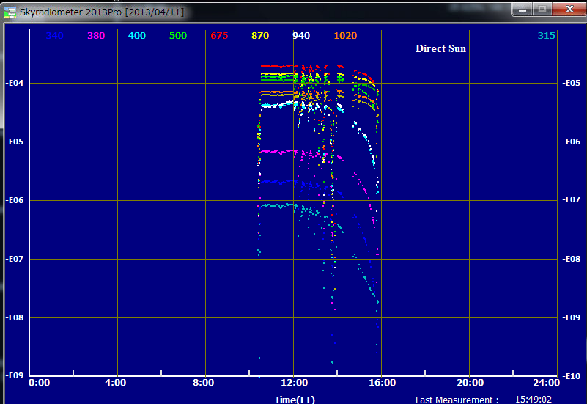
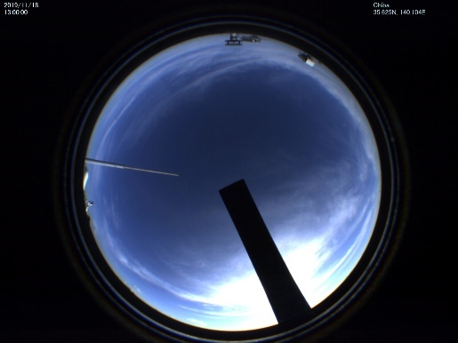
Direct Sun obs. by Chiba-U’s POM-02
This unstable feature was likely due to cirrus
13:00

Slide 2
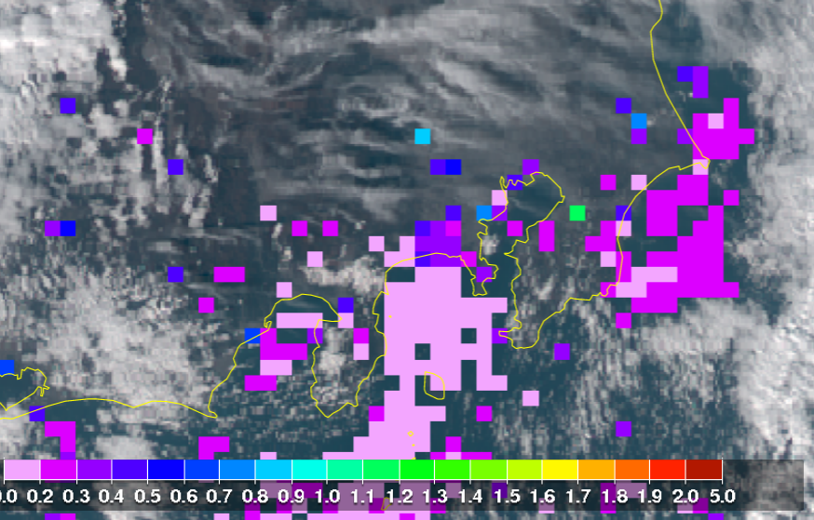
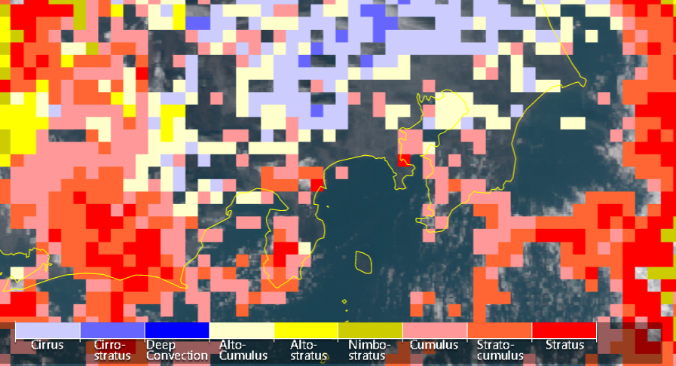
Himawari-8 data (13:00 JST)
AOT
Cloud type

Slide 3
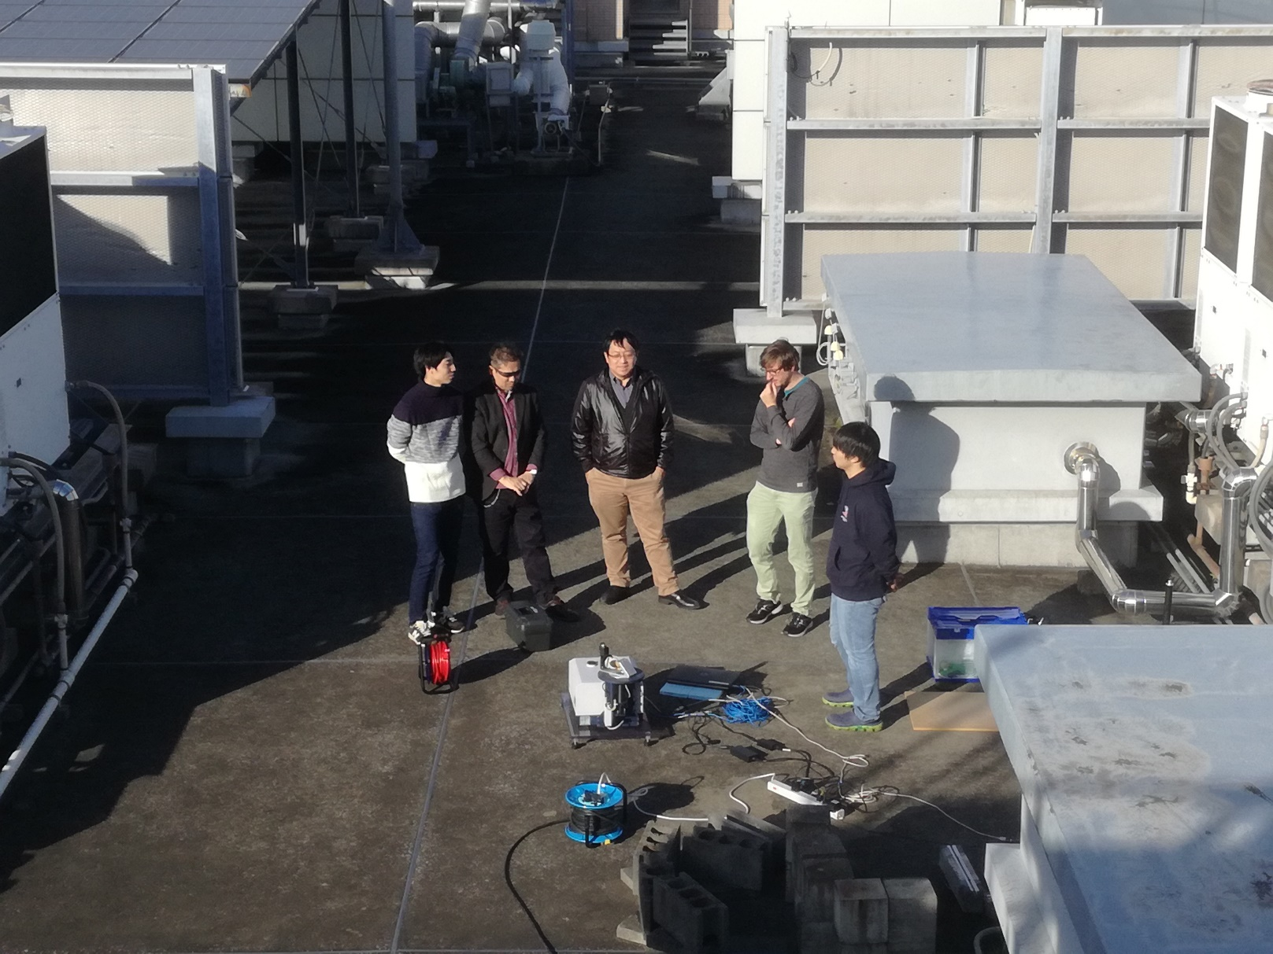
NIES’s FTS (EM21) instrument

Slide 4
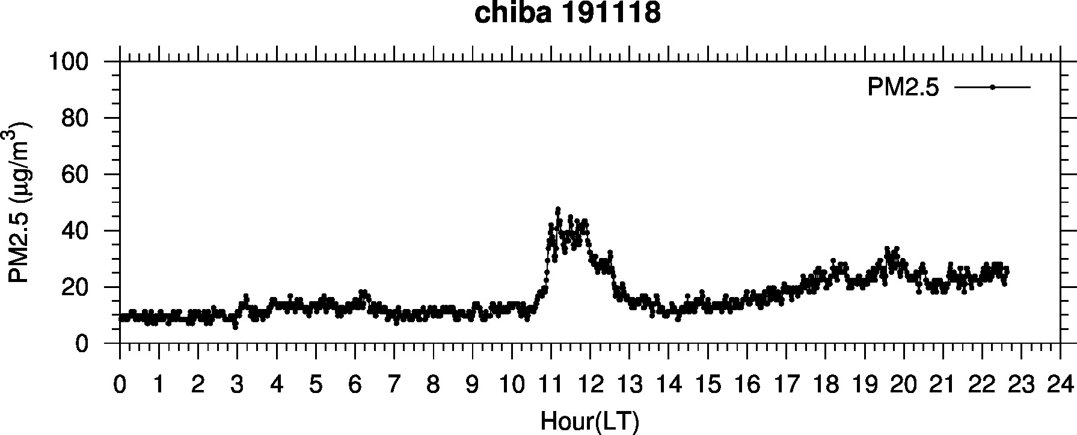
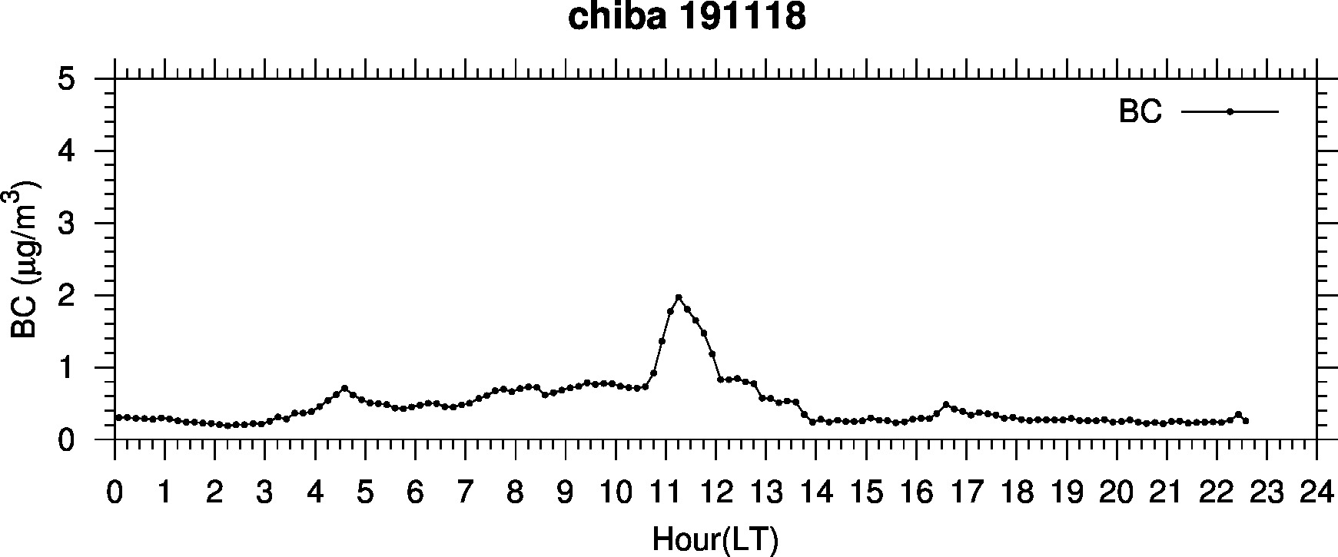
PM2.5 & BC

